Slide 1
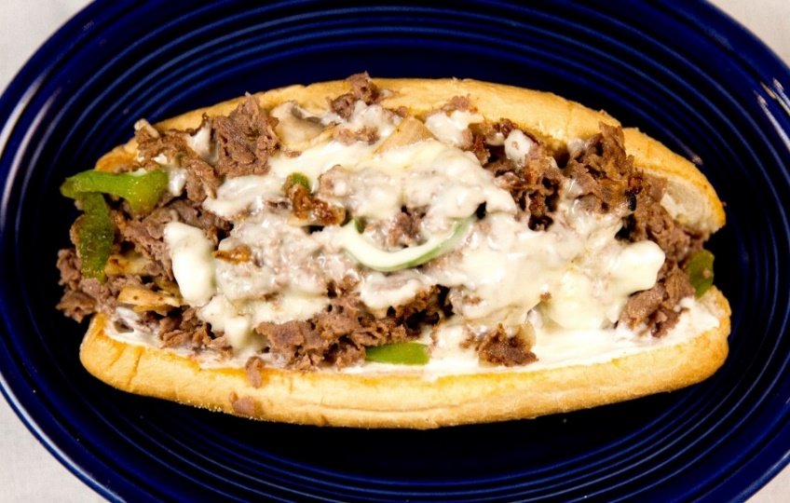
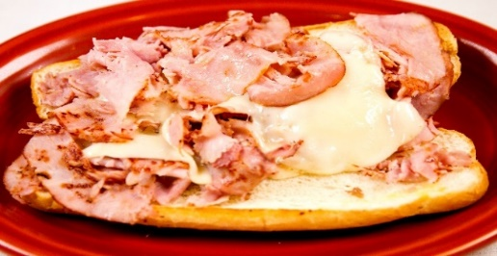
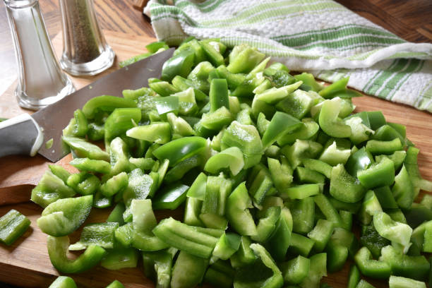
Philly Cheesesteaks
& Grilled Subs
Served on an Amoroso Hoagie!
The Monster $18.79
Triple Steak or Chicken, Onions, Green Peppers, Mushrooms, White American & Cream Cheese
Regular $10.19 Double meat $14.49
Naked Steak or Chicken & White American Cheese | Bayou Steak or Chicken, Onions, Green Peppers, White American Cheese & Bayou Sauce
Original Steak or Chicken, Onions & White American Cheese | Blackened Steak or Chicken, Onions, Green peppers, White American Cheese & Blackened Seasoning
Deluxe Steak or Chicken, Onions, Green Peppers & White American Cheese | Teriyaki Steak or Chicken, Onions, Green Peppers, White American Cheese & Teriyaki Sauce
Big Shroom Steak or Chicken, Onions, Mushrooms & White American Cheese | Italiano Steak or Chicken, Onions, Green Peppers, Provolone Cheese & Italian Seasoning
Supreme Steak or Chicken, Onions, Green Peppers, Mushrooms & White American Cheese | South Street Steak or Chicken, Onions, Green Peppers & Cheese Whiz
Creamy Steak or Chicken, Onions, Green Peppers & Cream Cheese | Hot Ham & Cheese Tavern Ham & Swiss Cheese
Spicy Steak or Chicken, Onions, Green Peppers, Jalapenos & Cream Cheese | Grilled Turkey & Swiss Cracked Peppermill Turkey & Swiss Cheese
Pepperjack Steak or Chicken, Onions, Green Peppers & Pepper Jack Cheese | Grilled Veggie Grilled Onions, Green Peppers, Mushrooms, Pickles, Banana Peppers, Black Olives, Tomatoes & White American Cheese
Make your steak better with
Bacon, Pepperoni,
Fried Egg or Extra Cheese
for only $1.59 each
Lettuce, Tomato, Banana Peppers or Black Olives
for only 59¢ each

Slide 2
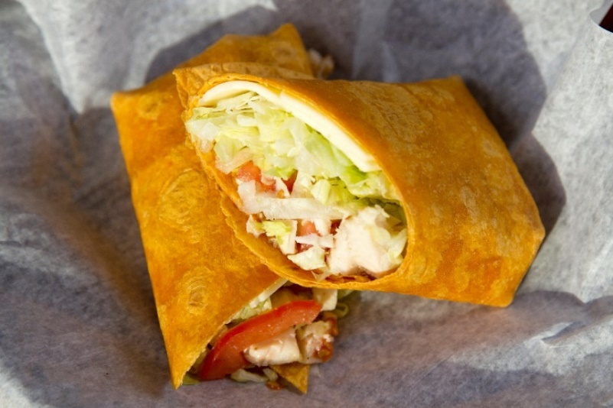
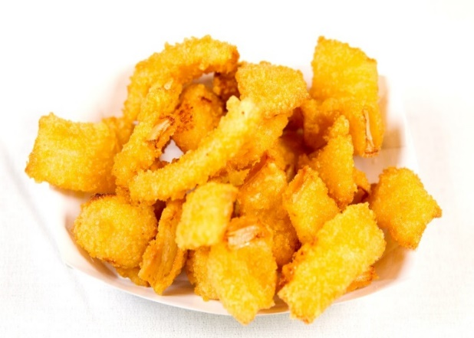
WRAPS
Served on a
Tomato Basil Wrap
--Sides--
Fries* $3.39
Onion Ring Bites $4.69
Chips $2.69
Cookie $2.49
Deli Pickle $2.49
Side Salad $2.79
Drinks $2.99
Cajun Wrap $9.39
Golden Classic® Chicken & Picante Provolone Cheese with Lettuce, Tomatoes, Onions, Boar’s Head Deli Dressing, Ranch dressing and Cajun seasoning
Ham & Cheddar Wrap $9.39
Tavern Ham & Vermont Cheddar Cheese with Lettuce, Tomato, Onions & Boar’s Head Deli Dressing
Honey Mustard Wrap $9.39
Golden Classic® Chicken & Picante Provolone Cheese with Lettuce, Tomatoes, Onions, Boar’s Head Deli Dressing and Honey Mustard dressing
Lemon Pepper Wrap $9.39
Golden Classic® Chicken, Cream Cheese with Lettuce, Tomato, Onions & Boar’s Head Deli Dressing and Lemon Pepper Seasoning
Jamaican Jerk Wrap $9.39
Golden Classic® Chicken & Picante Provolone Cheese with Lettuce, Tomatoes, Onions, Boar’s Head Deli Dressing, Ranch dressing and Jamaican Jerk seasoning
Turkey & Cheddar Wrap $9.39
Cracked Peppermill Turkey & Vermont Cheddar Cheese with Lettuce, Tomato, Onions & Boar’s Head Deli Dressing
*Add cheese sauce to fries for $1.59
--Salads--
Garden Salad $5.99
Chef Salad $9.39
Grilled Chicken Salad $9.39
Side Salad $2.79
Veggie Wrap $6.99
Lettuce, Tomatoes, Onions, Green Peppers, Black Olives, Picante Provolone Cheese, Boar’s Head Deli Dressing, Ranch Dressing and Roasted Garlic Seasoning
Roasted Garlic Wrap $9.39
Golden Classic® Chicken & Picante Provolone
Cheese with Lettuce, Tomatoes, Onions, Boar’s Head Deli Dressing, Ranch dressing and Roasted garlic seasoning
Make your wrap better with
Bacon, Pepperoni,
or Extra Cheese
for only $1.59 each
Banana Peppers or Black Olives
for only 59¢ each
--Kids--
Chicken Nuggets $2.79
Grilled Cheese $2.49
(with Ham) $4.49
(with Turkey) $4.49
Chicken Club Wrap $10.39
Golden Classic® Chicken, Vermont Cheddar Cheese, Turkey Bacon, Lettuce, Tomatoes, Onions, Boar’s Head Deli Dressing and Ranch dressing
double meat can be added to any wrap for only $4.30

